Slide 1
Example Problems
A gas undergoes a thermodynamic cycle consisting of three processes:
Process 1 - 2: Compression with pV = constant from p₁ = 10⁵ Pa,
V₁ = 1.6 m³, V₂ = 0.2 m³, (U₂ –U₁) = 0.
Process 2 – 3: Constant pressure expansion from V₂ to V₃.
Process 3 – 1: Constant volume, (U₃ –U₁) = -3549 kJ.
Sketch the cycle.
Determine the heat transfer and the work for process 2 – 3.
(a)
p
2
3
Notes:
For 1 - 2: Since ΔU₁₂ = 0, Q₁₂ = W₁₂
For 3 – 1: Since dV₃₁ = 0, W₃₁ = 0.
ΔU_{cycle} = 0.
1
V

Slide 2
Example Problems
(b)
The work in the process 2 – 3 is given by,
In order to determine this work, we need V₂ since we know that V₃ = V₁. We can get V₂ from the relation, pV = constant .
Also note that since ΔU₁₂ = 0, Q₁₂ = W₁₂ and,

Slide 3
Example Problems
Summary in kJ, note that ΔU for the cycle = 0.
U₁₂ = 0 | W₁₂ = -332.7 | Q₁₂ = -332.7
U₂₃ = 3549 | W₂₃ = 1120 | Q₂₃ = 4669
U₃₁ = -3549 | W₃₁ = 0 | Q₃₁ = -3549
W_{cycle} = Q_{cycle} = 787.3 kJ

Slide 4
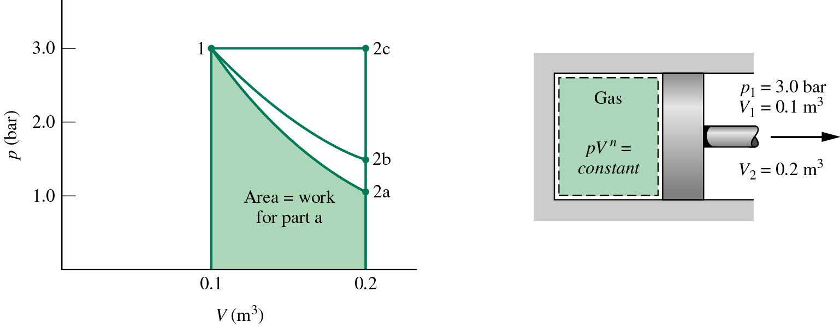
A gas in a piston-cylinder assembly undergoes an expansion process
for which the relationship between pressure and volume is given by
PV^{n} = constant = A
The initial pressure is 3 bars, the initial volume is 0.1m³
and the final volume is 0.2 m³. Determine the work for the process in kJ if
(a) n = 1.5, (b) n = 1.0 and (c) n = 0.

Slide 5
In each case the work is given by,
The constant A can be evaluated at either end state
This expression is valid for all n except n =1.

Slide 6
(a) To evaluate W, the pressure at state 2 is required.
(b) For n = 1 we need to consider this special case,

Slide 7
(c) For n = 0, the pressure volume relation is just p = A

Slide 8
Example Problems
A gas is enclosed in a cylinder with a movable
piston. Under conditions that the walls are
Adiabatic, a quasi-static increase in volume
results in a decrease in pressure according to,
P_{A}, V_{A}
Find the quasi-static work done on the system and the net heat transfer to the
system in each of the three processes, ADB, ACB and the linear AB. In the process ADB the gas is heated at constant pressure (P = 10⁵ Pa) until its volume increases from 10⁻³ to 8 x 10⁻³ m³. The gas is then cooled at constant volume until its pressure decreases to 10⁵/32 Pa. The other processes (ACB and AB) can be similarly interpreted according to the figure.
A
D
10⁵
P (Pa)
10⁵/32
C
B
W_{AB}
10⁻³
8 x 10⁻³
V (m³)

Slide 9
Example Problems
From the first Law: ΔU = Q – W
For the adiabatic process: ΔU = – W
For the process ADB:
but, and from the result of the adiabatic process

Slide 10
Example Problems
Similarly for the process ACB: we find that W_{ACB} = -21.9 J and Q_{ACB} = -90.6 J
For the process AB: W can also calculated from the area:
Note that while we can calculate Q_{ADB} and Q_{ACB} , we can not calculate Q_{AD} , Q_{DB ,} Q_{AC} and Q_{CB} , separately for we do not know (U_{D} – U_{A}) or (U_{C} – U_{A}).

Slide 11
Given the standard enthalpies of formation, ,find the enthalpy for the
following reaction at 298K and 1 atmosphere pressure.
MnSiO₃ -246
MnO -384
SiO₂ -910

Slide 12
Given the specific heat functionality find the heat of reaction at 800K.
Heat capacity Constants (J/mol-K)
c x 10⁻⁵
Temp range (K)
a
b x 10³
MnSiO₃ 110 16.2 -25.8 298-1500
MnO 46.0 8.2 -3.7 298-900
SiO₂ 46.9 34.2 -11.3 298-1000
First bring each of the components in the reaction from 298K to 800K

Slide 13
Then evaluate ΔH for the reaction at 800K
Δa =-17.1
Δb = 26.2 x 10⁻³
Δc = 10.8 x 10⁵

Slide 14
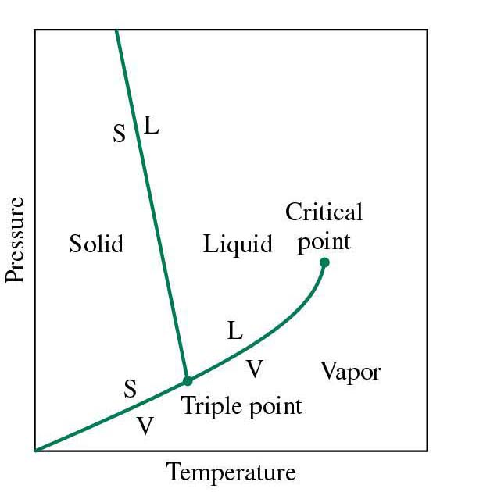
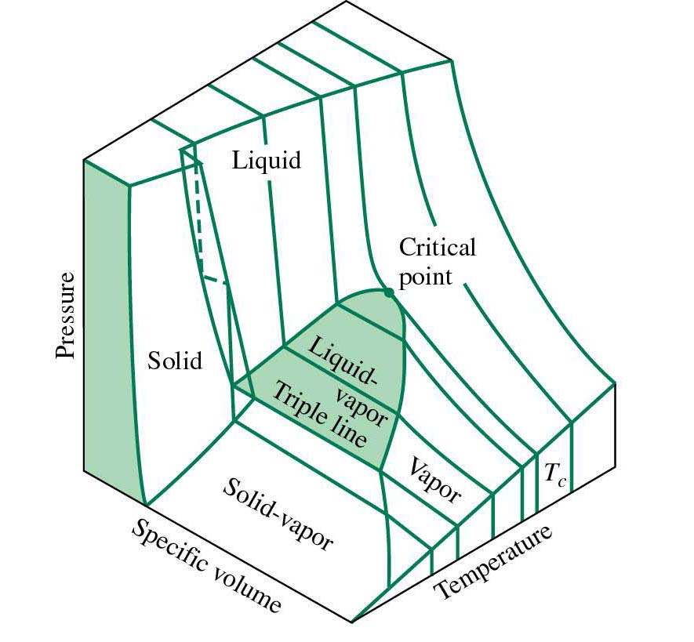
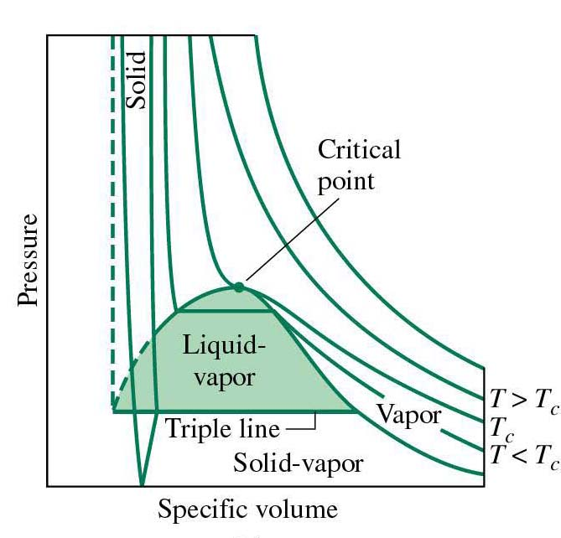
P,V, T Relations and Thermodynamic Properties
Graphical equation of state
P, v, T surface projected
on the P-T plane.
Phase diagram
P,v, T surface projected
on the P- v plane.
P,v, T surface for a substance
that expands on freezing.
v = V/m, specific volume

Slide 15
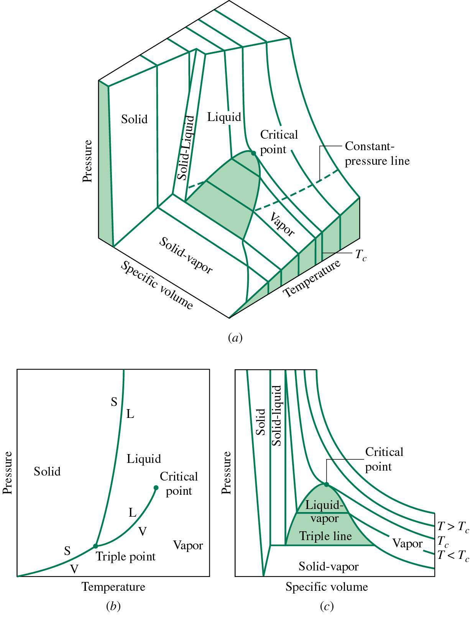
P,V, T Relations and Thermodynamic Properties
Graphical equation of state
P,v, T surface for a substance
that contracts on freezing.
Phase diagram and P-v surface
for a substance that contracts on
freezing.

Slide 16
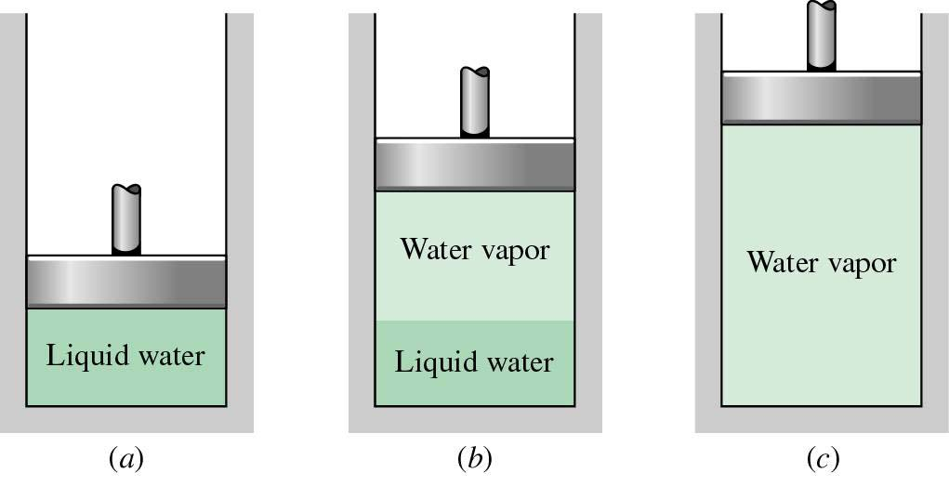
P,V, T Relations and Thermodynamic Properties
Phase change: consider a container of liquid water heated at constant
pressure (1 Atm ~ 10⁵ Pa)
The temperature of the water
rises to 100 C.
(b) At 100 C the heat energy goes
into converting the liquid water to
water vapor. The volume of the
system increases. The temperature
of the two – phase, liquid/vapor
system stays constant (100 C) until
the last drop of liquid disappears.
(c) After all the fluid is converted to vapor, the temperature and volume rise as
heat is added to the vapor.

Slide 17
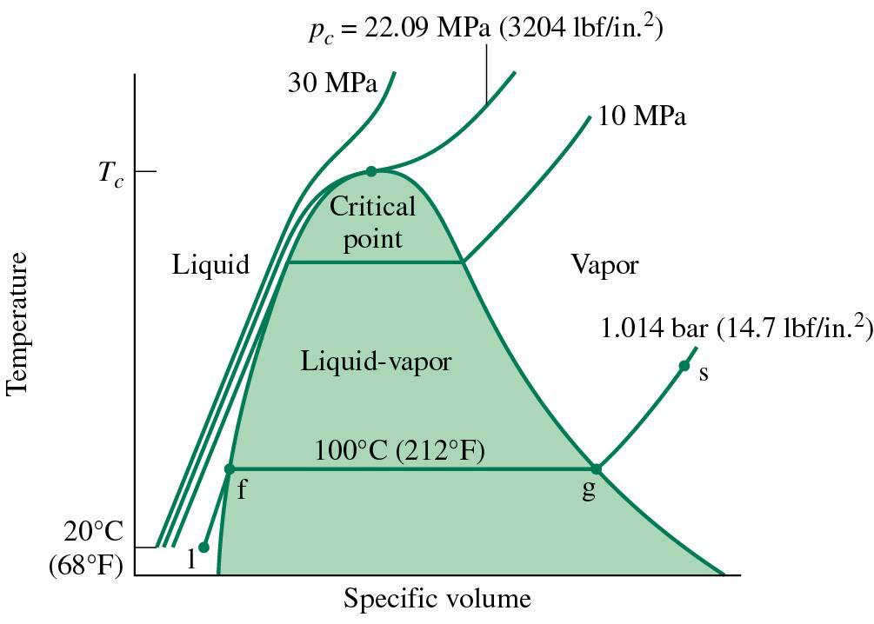
P,V, T Relations and Thermodynamic Properties
Saturated liquid
Saturated vapor
1-x
x
f
g
v_{f}
v
v_{g}
v-v_{f}
v_{g}-v
v_{f}
v
v_{g}
P,v, T surface projected on
the T- v plane for water.
x is the mass fraction of the
vapor called the quality.
Lever rule:
rule of mixtures

Slide 18
P,V, T Relations and Thermodynamic Properties
Specific internal energy and enthalpy
u = U/unit mass (J/kg)
h = H/unit mass (J/kg)
u = Q/mass – W/mass
h = u + pv
The simple rule of mixtures can always be used for any of the specific
quantities (v, u, h):
h = (1-x)h_{f} + xh_{g}
u = (1-x)u_{f} + xu_{g}
v = (1-x)v_{f} + xv_{g}
h, u, v are the specific enthalpy, internal energy, and volume in the two-phase
fluid/gas region.

Slide 19
Example
Water in a piston cylinder assembly undergoes two processes from an initial state
where the pressure is 10⁶ Pa and the temperature is 400 C.
Process 1-2: The water is cooled as it compressed at constant pressure to the
saturated vapor state at 10⁶ Pa.
Process 2-3: The water is cooled at constant volume to 150 ºC.
Sketch the processes on p-v and T-v diagrams.
For the overall process determine the work and heat transfer in kJ/kg.
Water
Boundary
1
10⁶ Pa
400 C
P (10⁵ Pa)
2
1
179.9 C
2
10
400 C
T (ºC)
179.9 C
150 C
4.758 x 10⁵ Pa
4.758
3
3
150 C
v (m³/kg)
v (m³/kg)

Slide 20
The only work done in this process is the constant pressure compression,
process 1-2, since process 2-3 is constant volume.
Since for state 1 we know P and T, we can get the specific volume from a data Table,
(properties of superheated water vapor) v₁ = 0.3066 m³/kg. The specific volume
at state 2 is the saturated value at 10 bar v₂ = 0.1944 m³/kg.
W/m = 10⁶ (0.1944 – 0.3066) = -112.2 kJ/kg
The minus sign indicates
work done ON the system
From the 1st Law, Q = ΔU + W, and dividing through by the mass,

Slide 21
u₁ is the specific internal energy in state 1, which we can get also get
from a Table as 2957.3 kJ/kg.
To get u₃ note that we are in a 2-phase fluid/vapor region, so u₃ will be a linear
combination of u_{f} and u_{g} determined from the quantity of fluid and vapor present
at v₃ = v₂. The mass fraction of vapor present or “quality” is given by,
Table
P (10⁵ Pa)
2
1
10
400 C
179.9 C
4.758
3
150 C
Then using the rule of mixtures we can evaluate
u₃.
v (m³/kg)
v_{f}
v₃
v_{g}
631.68
2559.5
Finally,
The minus sign indicates that heat is
transferred OUT of the system

Slide 22
A two-phase liquid-vapor mixture is initially at 5 bar in a closed container of
volume 0.2 m³ and “quality”, x = 0.10. The system is heated until only saturated
water remains. Determine the mass of the water in the tank and the final pressure.
Given Data
V = 0.2 m³
P₁= 5 bar
x₁ = 0.10
x₂ = 1.0 (saturated water)
Using the Table:
State 1:
v_{f1}= 1.0296 x 10⁻³ m³/kg
v_{g1}= 0.3749 m³/kg
H₂O
The water is in a closed system and the total volume and mass are constant.
P (bar)
?
2
P₂ =?
5.0
1
P₁
v
linearly extrapolated between
50 and 60 bar.
v_{f1}
v
v_{g1}

